Slide 1
Phoswich GATE Simulation OCTAVE Processing
Bill Worstell
PicoRad
1/11/2022

Slide 2
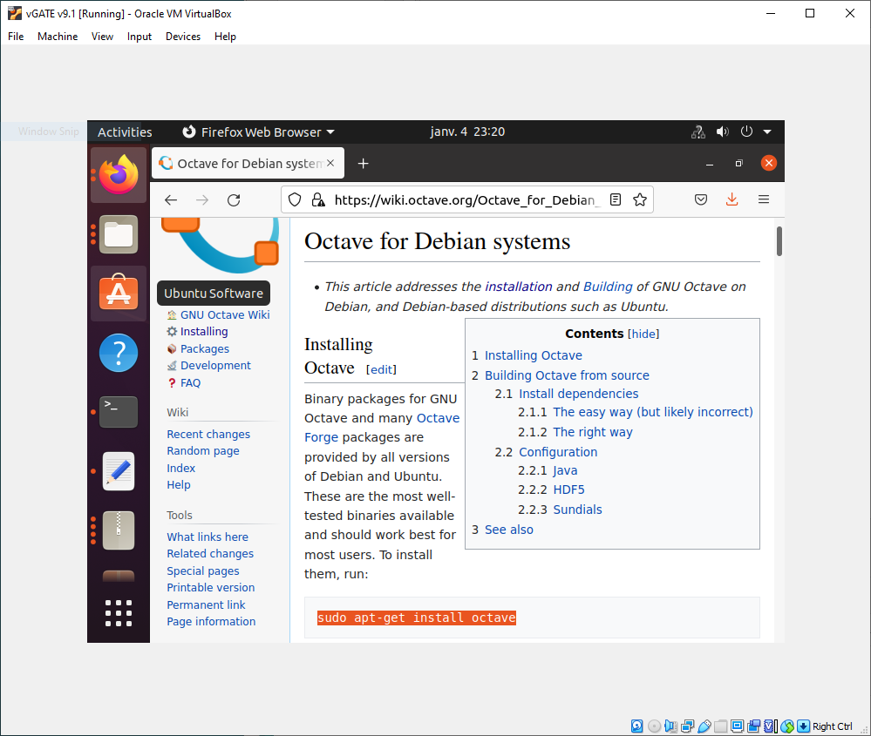
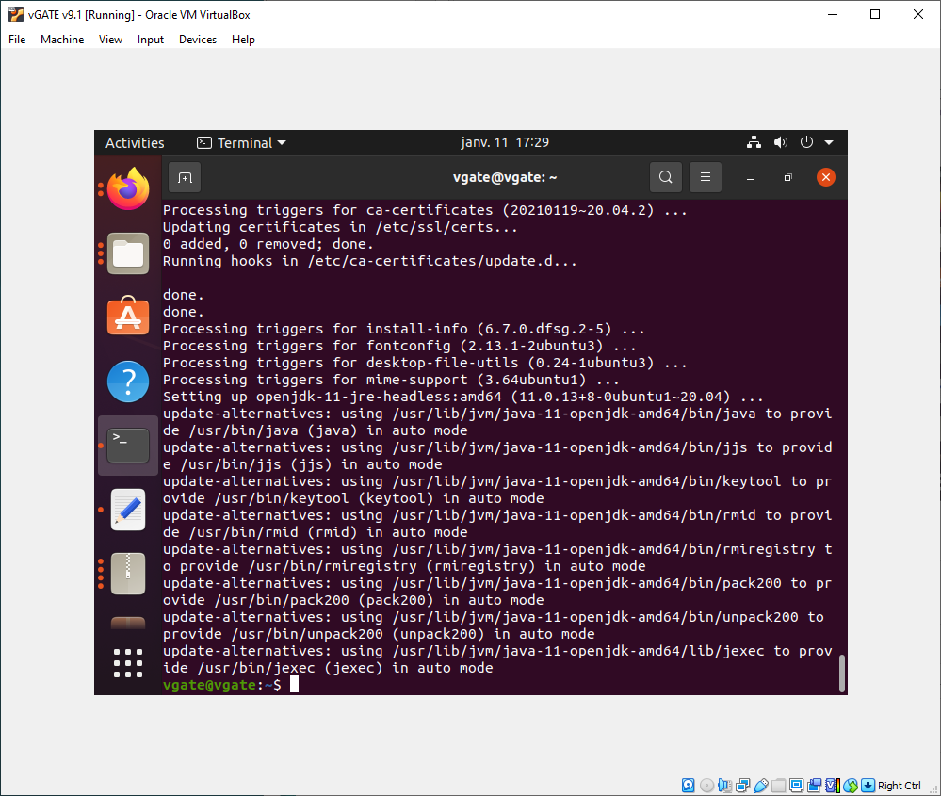
Virtual Machine
Downloading and installing OCTAVE

Slide 3
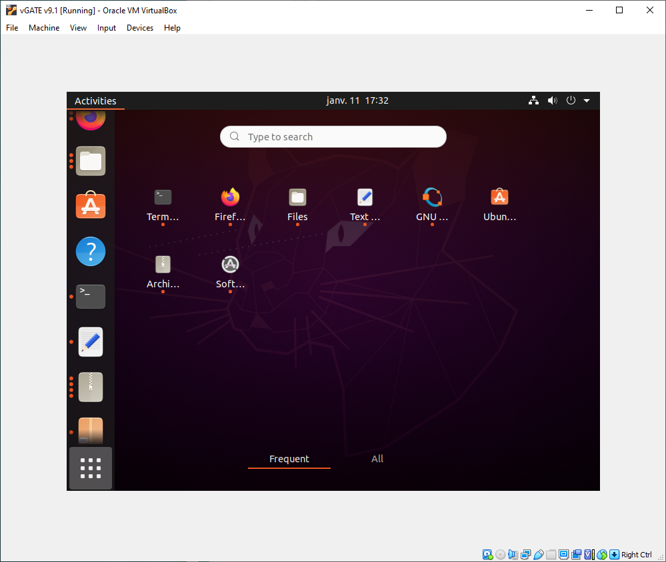
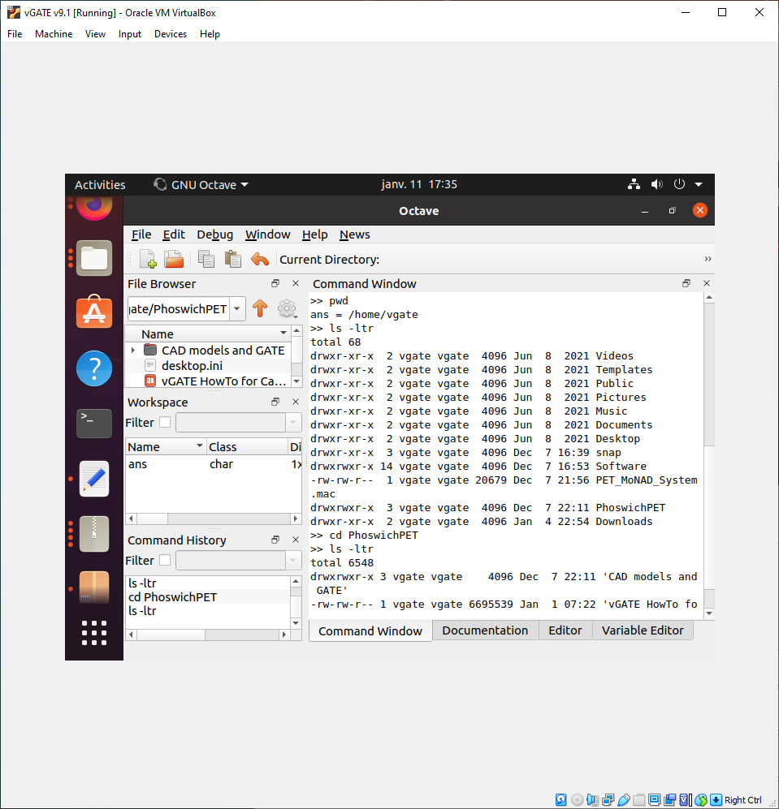
Virtual Machine
Launching OCTAVE

Slide 4
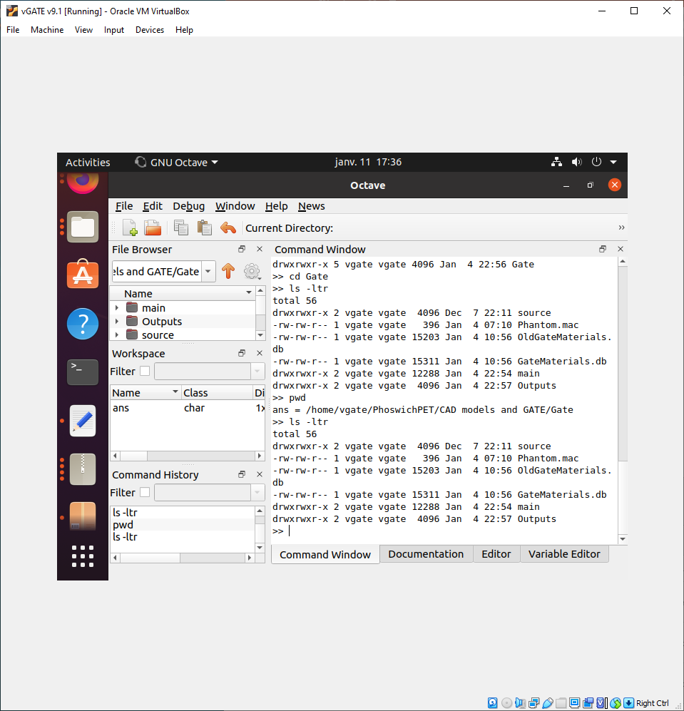
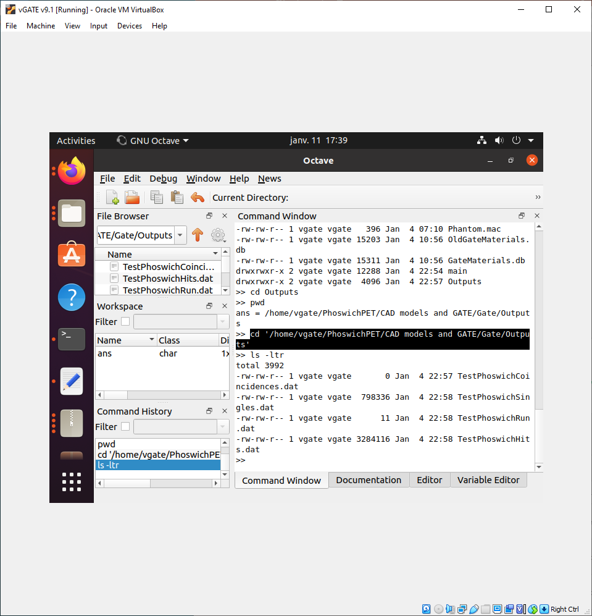
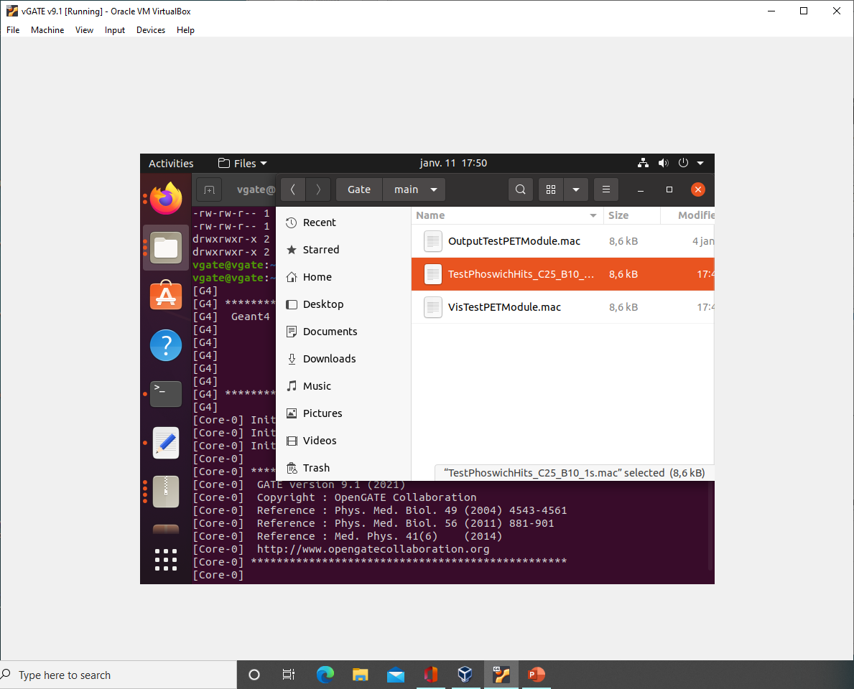
GATE .mac script
TestPhoswichHits_
C25_B10_1s.mac
Virtual Machine
Go to Gate Directory

Slide 5
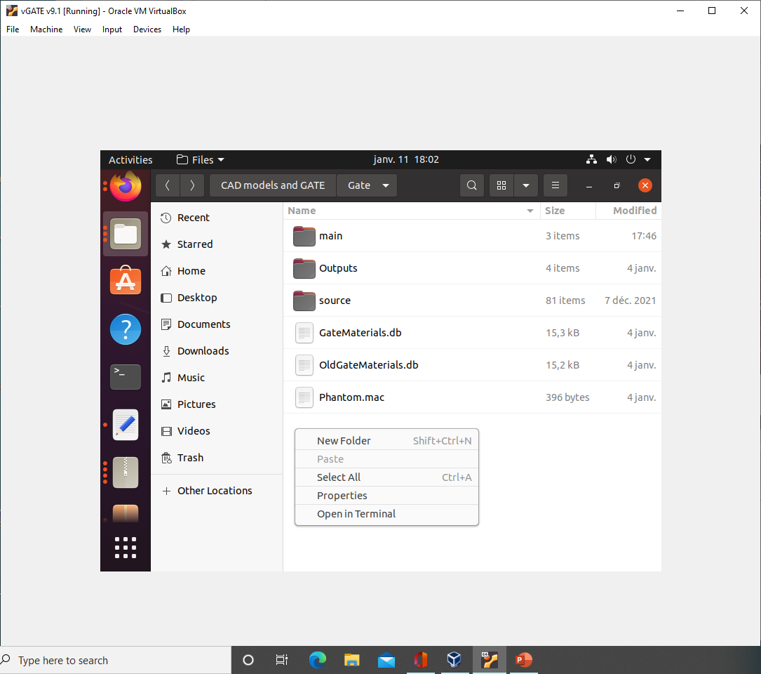
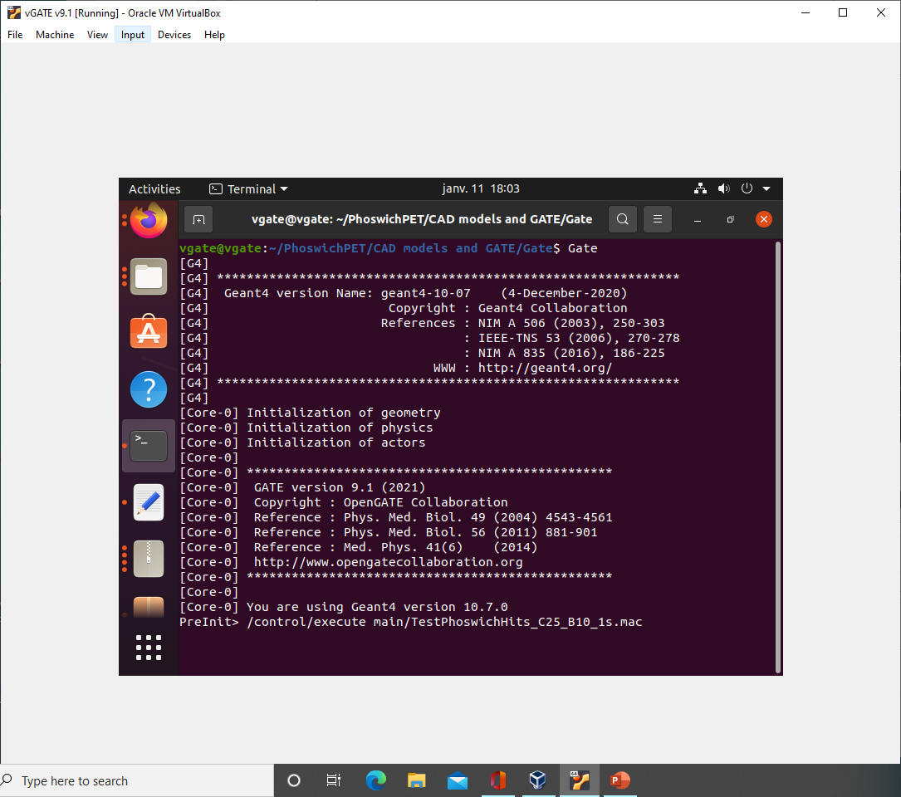
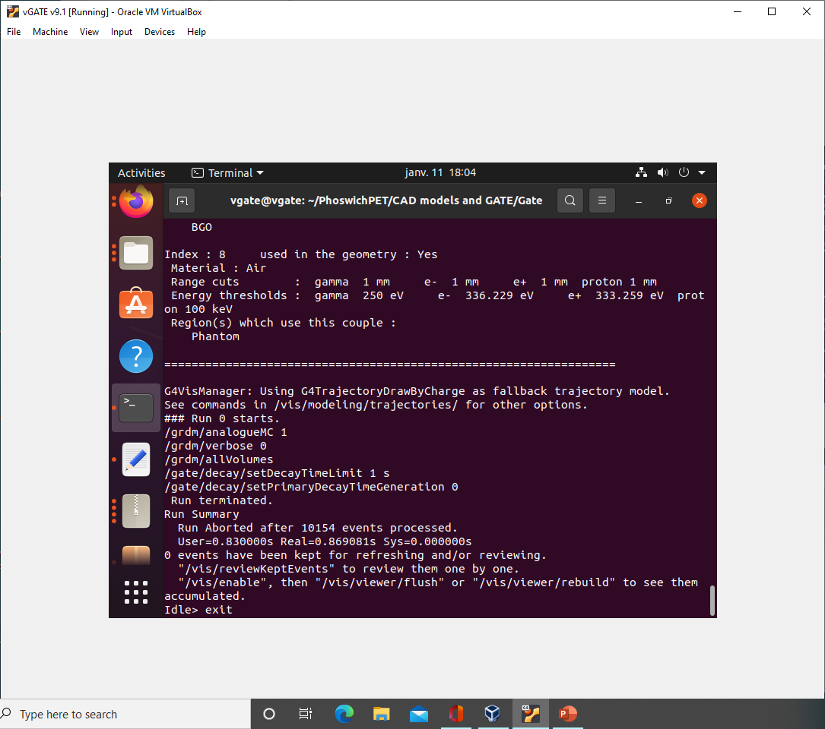
Launching GATE on
Virtual Machine

Slide 6
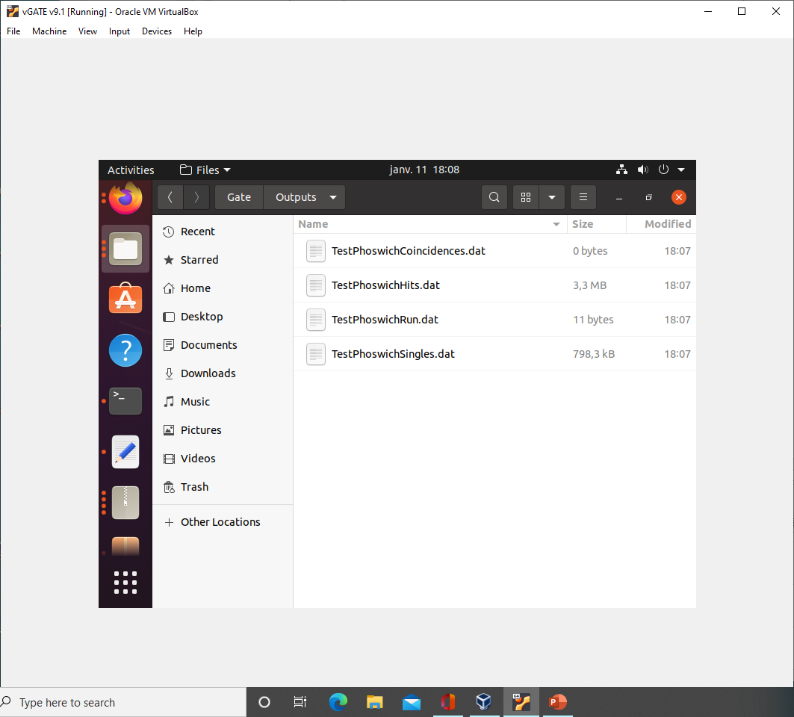
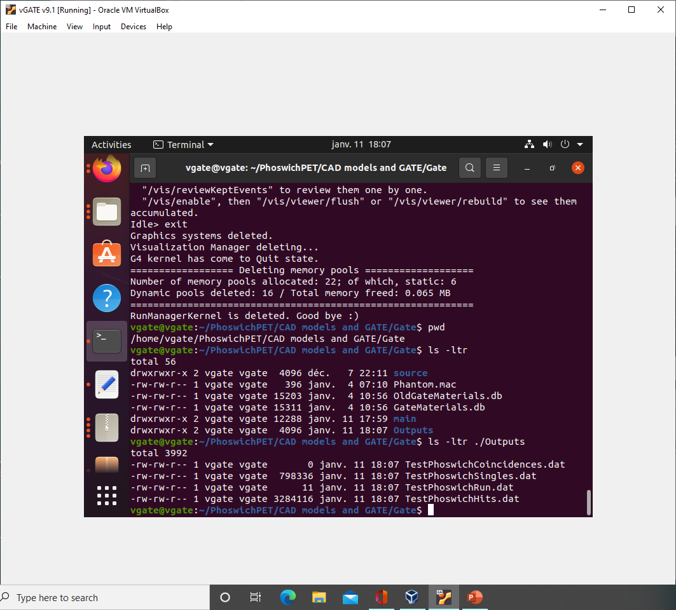
GATE Outputs on
Virtual Machine

Slide 7
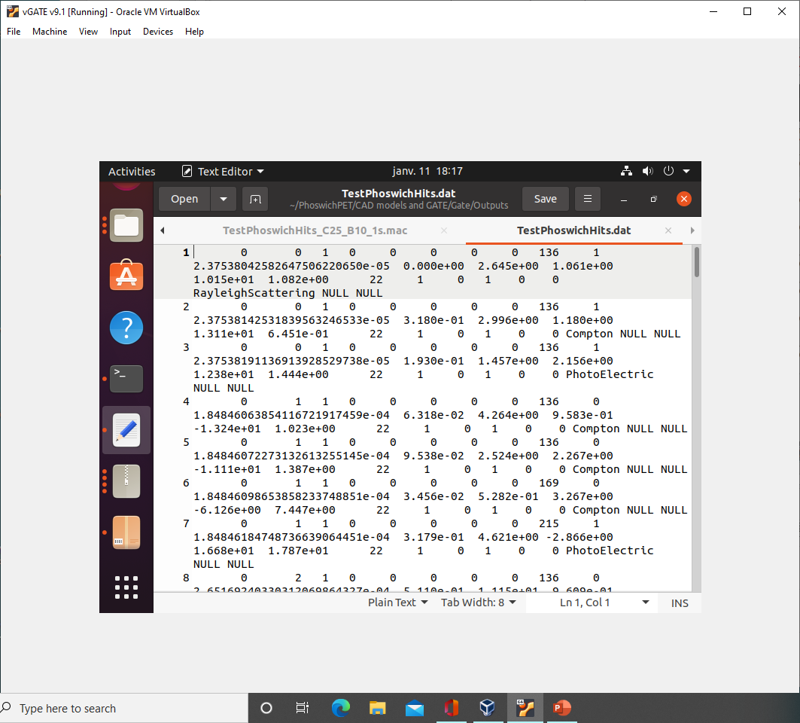
GATE Hits Output
Run
Crystal
Event
Layer
Fields:
1-> Run
2-> Event
9-> Crystal
10-> Layer
11-> Time
12-> Energy
13-> Range
14-> X
15-> Y
16-> Z
23-> Type
Interaction Type
Time (s)
Y
Energy
(MeV)
Range
X
Z

Slide 8
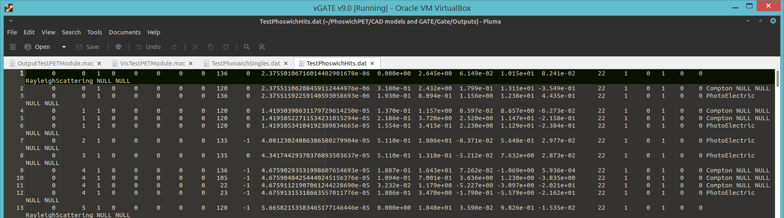
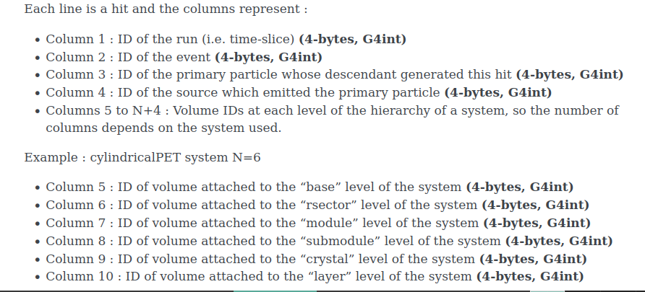
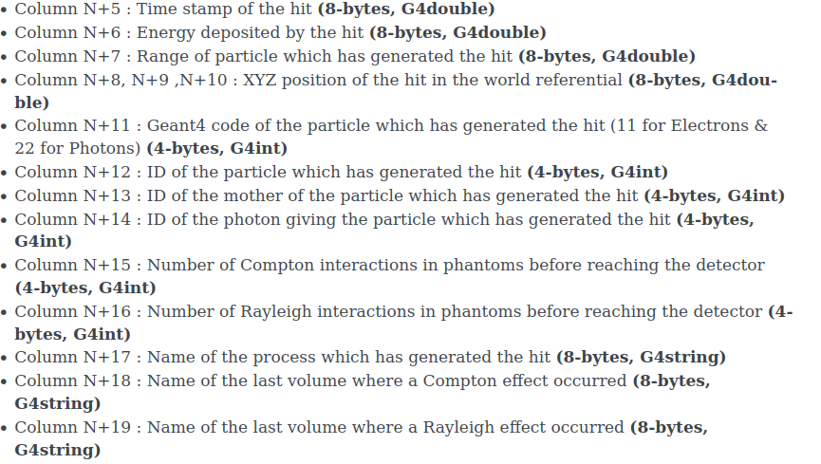
GATE Hits Output
Event
Layer
Energy
(MeV)
X
Y
Z
Interaction Type
Run
Time (s)
Range
(mm)
Crystal

Slide 9
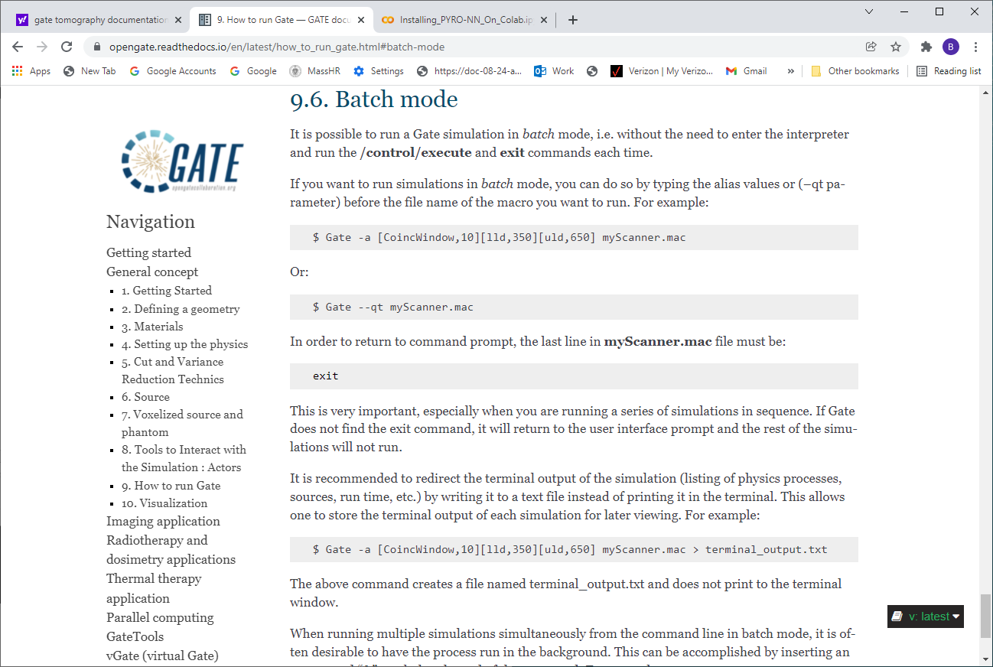
Running GATE in Batch mode

Slide 10
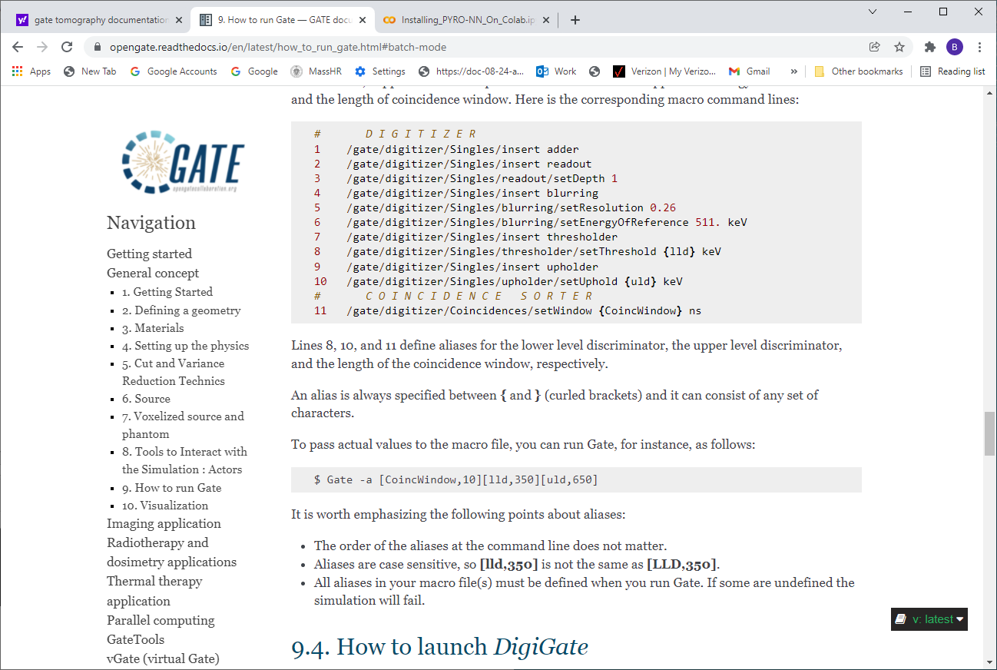
Setting GATE Run-Time Parameters

Slide 11
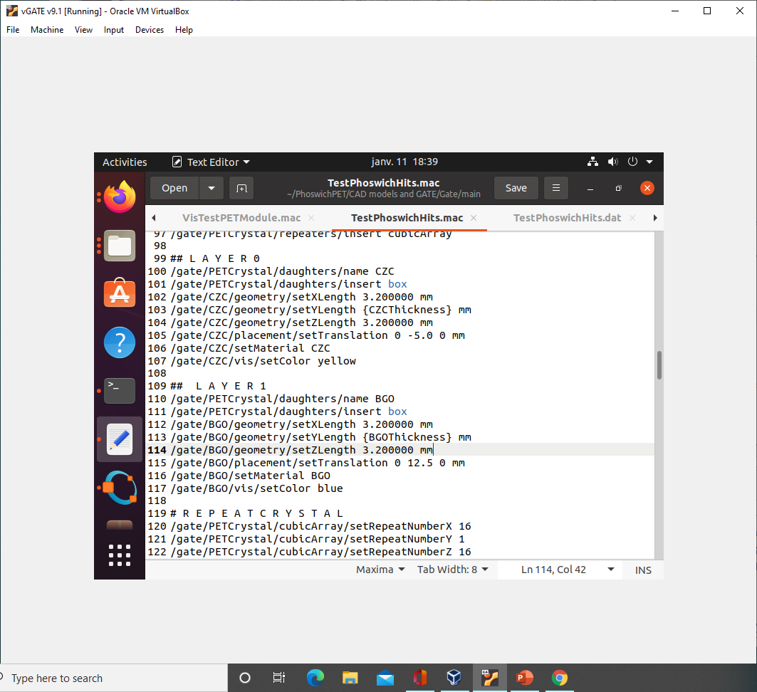
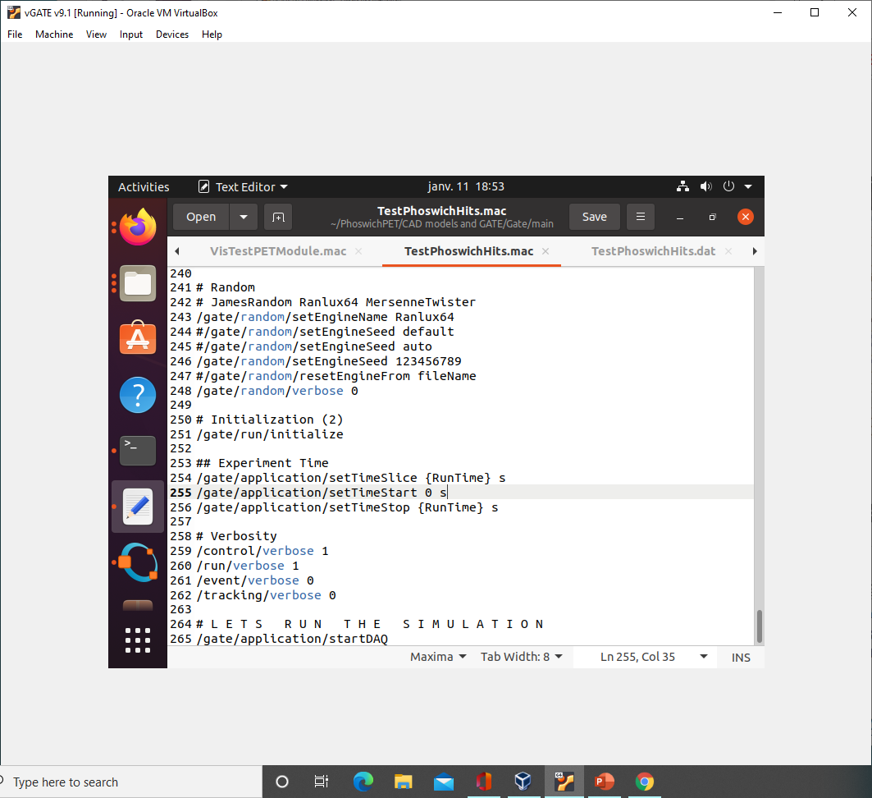
$Gate –a [CZCThickness 25] [BGOThickness 10] [RunTime 1] TestPhoswichHits.mac

Slide 12
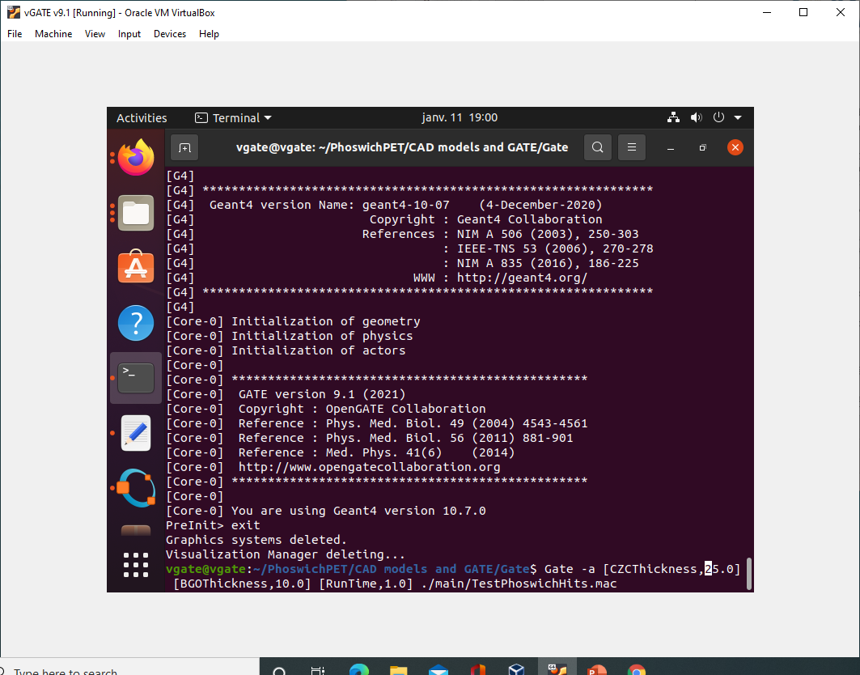
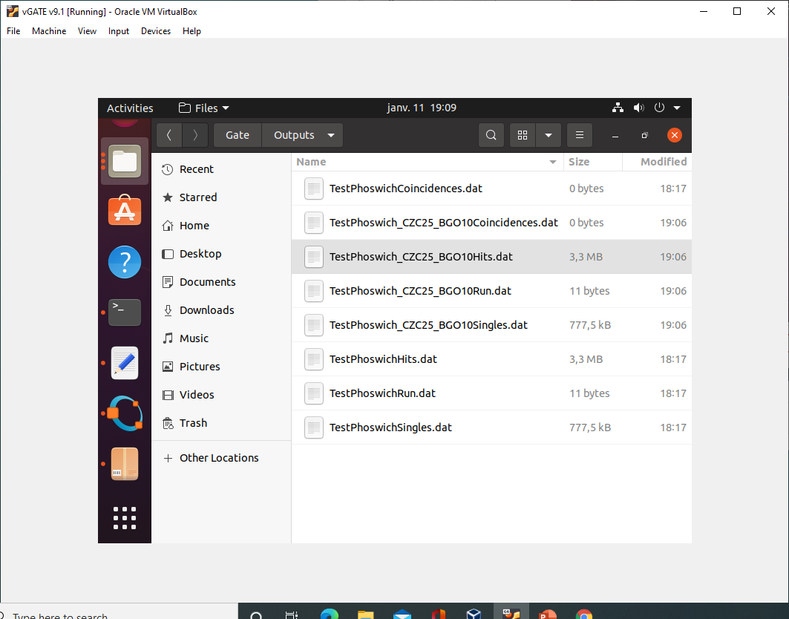
$Gate –a [CZCThickness,25][BGOThickness,10][RunTime,1] TestPhoswichHits.mac

Slide 13
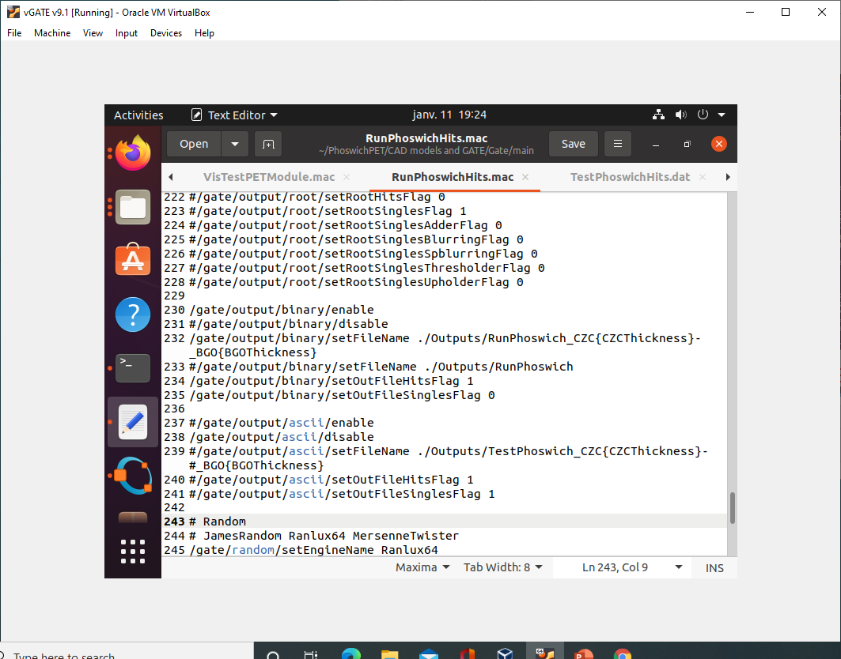
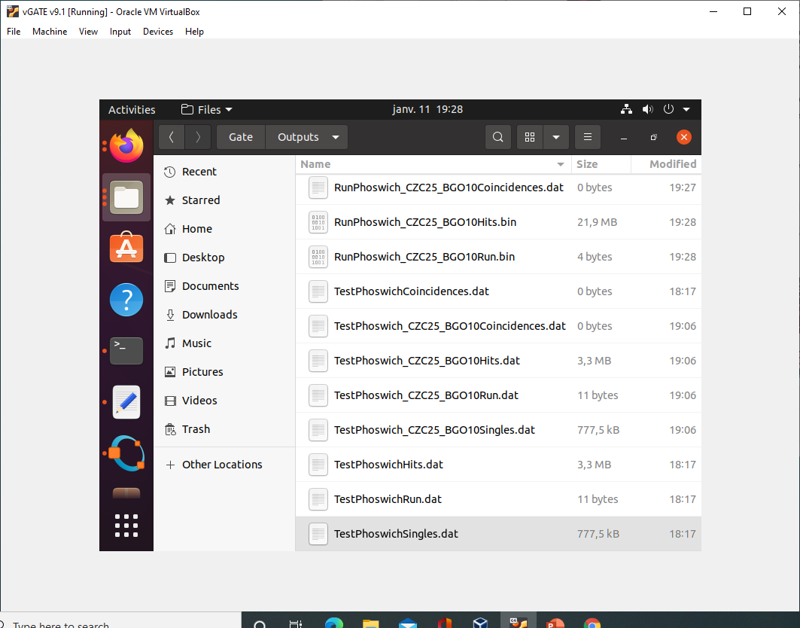
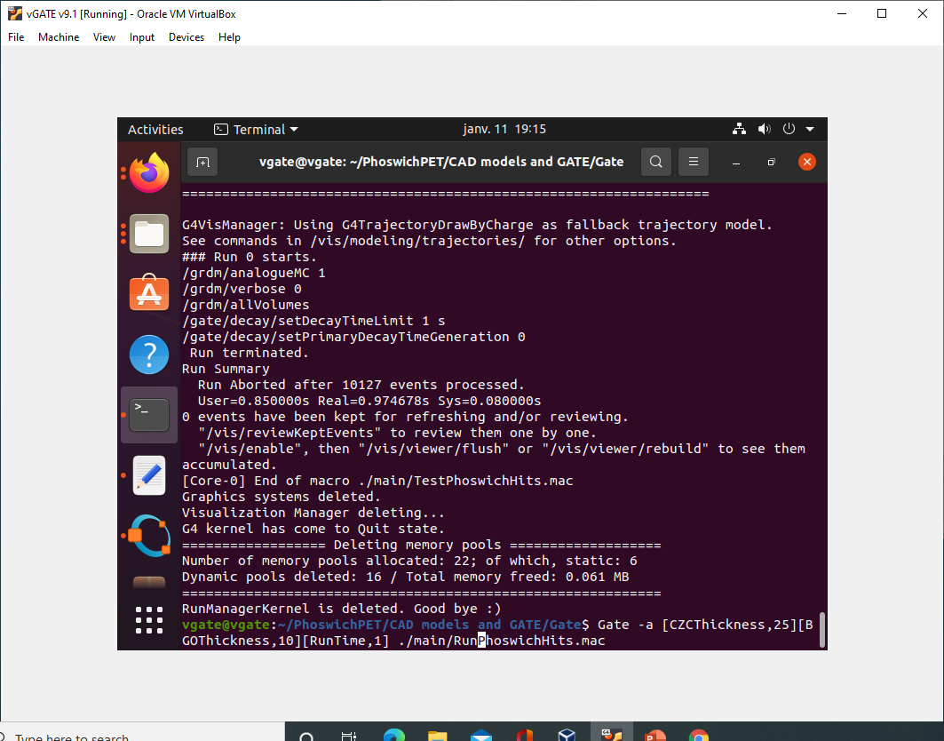
$Gate –a [CZCThickness,25][BGOThickness,10][RunTime,1] RunPhoswichHits.mac

Slide 14
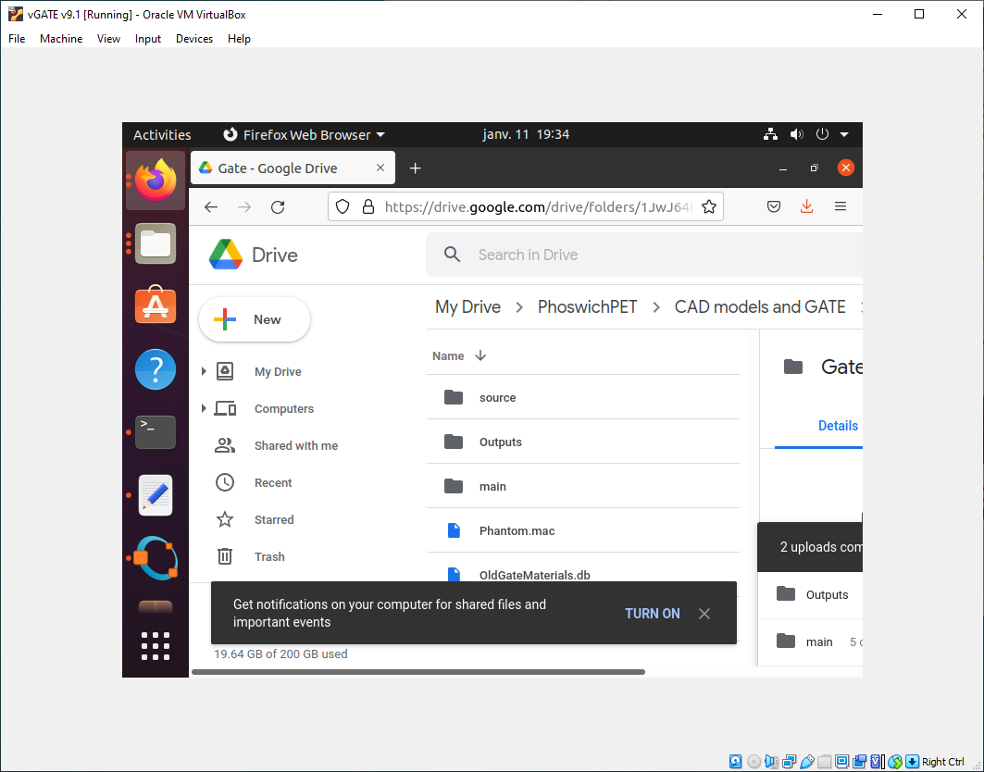
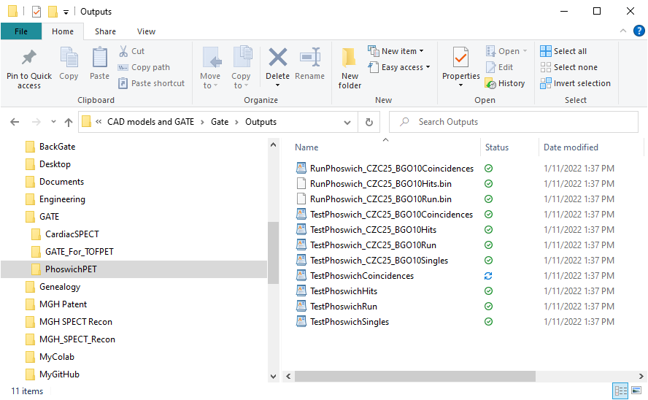
Fetching Outputs to
Local Machine

